Slide 1


Predict Clicked Ads Customer Classification by using Machine Learning
Created by:
Muhammad Iqbal Mudzakky
Email : iqbalmudzakky@gmail.com
LinkedIn : (4) Muhammad Iqbal Mudzakky | LinkedIn
Github : iqbalmudzakky (github.com)
“Iqbal is a junior data scientist with a robust background
in exploratory data analysis, preprocessing, modeling,
visualization, and providing actionable insights. He
possesses extensive experience in handling diverse data
types, particularly in the Fintech and E-Commerce
industries. His expertise is evident through successful
completion of numerous supervised and unsupervised
learning projects, which demonstrate his ability to
extract valuable information from data, develop accurate
models, and effectively communicate findings. With a
proven track record in multiple facets of data science,
Iqbal serves as a highly valuable asset to any team or
organization seeking expertise in data-driven decision
making and problem-solving. ”

Slide 2
PROJECT BACKGROUND

Slide 3
Company Background
“In the world of digital marketing, online ads are essential for promoting products and services. To improve ad effectiveness, companies use machine learning to understand customer behavior and preferences.
By analyzing customer behavior, companies can figure out which ads are more likely to catch their attention and interest, enabling them to show more relevant ads.”

Slide 4

Goals
Goals?
is to create a machine learning model that sorts customers based on their chances of clicking on specific ads. This way, the project aims to gain valuable insights into different customer types and their responses to ads.

Slide 5

Introduction
The Main Issue/Problem?
“How to identify and classify customers based on their likelihood to click on specific ads.”

Slide 6

Workflow
1. Exploratory Data Analysis
2. Data Cleaning & Preprocessing
3. Data Modeling
4. Business Recommendation and Simulation

Slide 7
EXPLORATORY DATA ANALYSIS

Slide 8
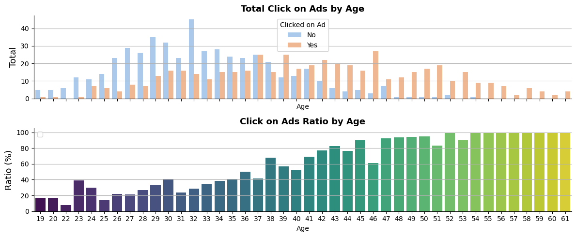

Exploratory Data Analysis
The chart shows that users under 35 years old are less likely to click on ads, while those above 35 are more likely to click. The most significant user group falls into the 32-year age range.
Total User
1000

Slide 9
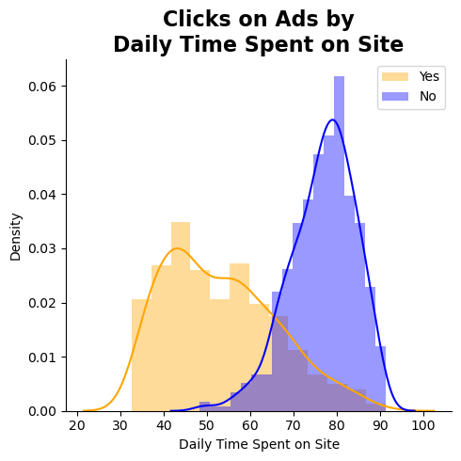
Exploratory Data Analysis
Total User
1000
The chart shows that fewer users click on ads compared to those who don't. Users who don't click on ads spend more time on the website, around 60 to 90 seconds on average, while those who click on ads spend around 30 to 80 seconds on average.

Slide 10
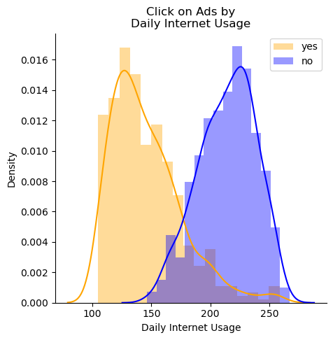
Exploratory Data Analysis
Total User
1000
The chart shows that users who don't click on ads use more internet data, mostly between 200 to 250 MB, while users who click on ads use less data, typically between 100 to 150 MB.

Slide 11
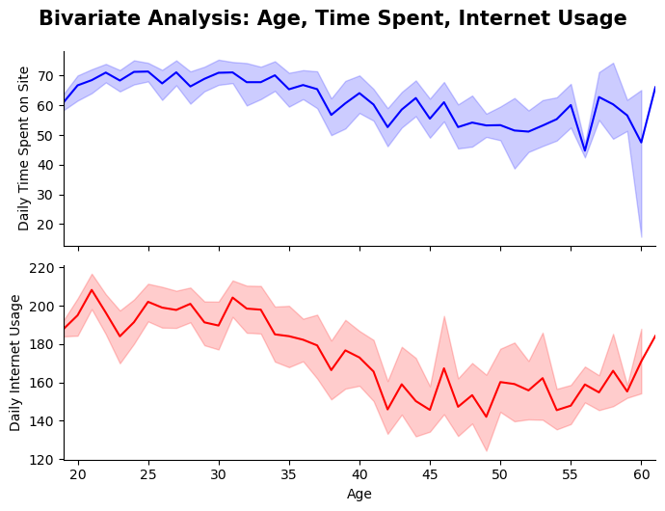
Exploratory Data Analysis
This chart represents the correlation between the age column and internet usage, as well as the time spent. From both plots, we can conclude that there is a negative correlation between age and internet usage, as well as between age and time spent. In other words, as age increases, both internet usage and time spent tend to decrease.

Slide 12
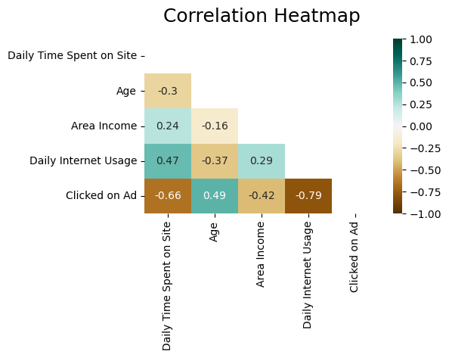
Exploratory Data Analysis
Based on the chart, each feature has a relatively strong correlation with the target feature. Additionally, there are some features that show strong correlations with each other, such as internet usage with time spent, internet usage with age, and age with time spent. In other words, these features have a significant relationship with each other, and their values tend to change together.

Slide 13
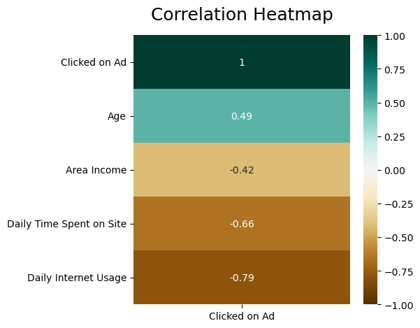
Exploratory Data Analysis
The correlation between independent features and the dependent feature (target feature = 'Clicked on Ad') can be seen more clearly in the adjacent chart. Among the four features, only the "age" feature has a positive correlation, which means that as the user's age increases, the likelihood of clicking on the ad also increases. On the other hand, for the other features, as their values increase, the probability of clicking on the ad decreases.

Slide 14
DATA CLEANING AND PREPROCESSING

Slide 15

Data Cleansing and Preprocessing
Handle Missing
Value
Handle Data
Duplicate
Feature
Engineering
Feature
Encoding
Split Feature
And Target
Time Spent
Income
Internet Usage
Gender
Extract Timestamp :
years
months
weeks
days
Gender
Clicked Ads
City
Province
Category
X (Feature) :
Time Spent, Age, Income, Internet Usage, Gender, City, Province, Category, Bulan, Pekan, Tanggal.
y (Target) :
Click ads

Slide 16


THANK YOU
Click icon for the code :

